Slide 1

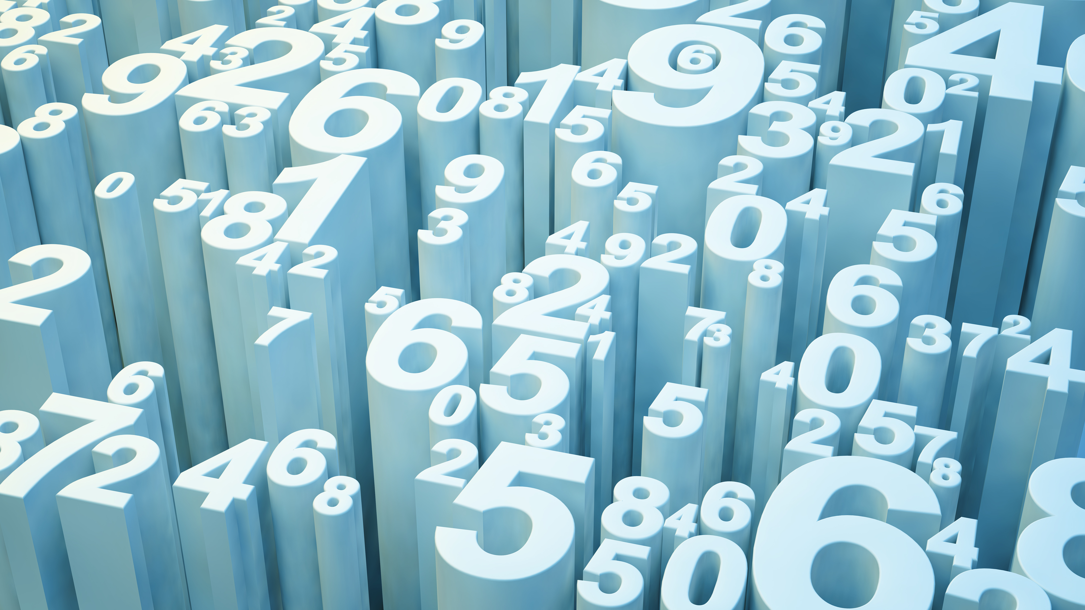
Predictive Quantification of Locomotion using BMS
Shivani Patel

Slide 2
Objective
Train and refine a model capable of taking in labeled auto-calculated data to predict BMS values (target variables) for both right and left sides of a mouse model
Baseline Accuracy
BMS-L: 19%
BMS-R: 11%

Slide 3
The Data
AutoCalc Parameters
Combination of numeric values – recorded and calculated
Variables such as step counts, distances, angles, ratios, etc
BMS Labels
Manually recorded observed values
BMS scale (0 to 9)

Slide 4
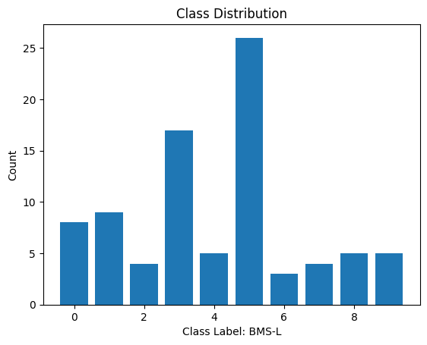
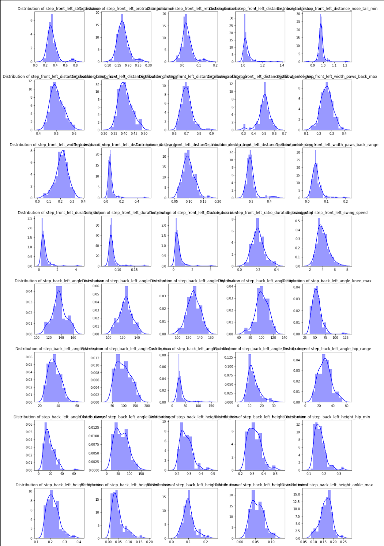
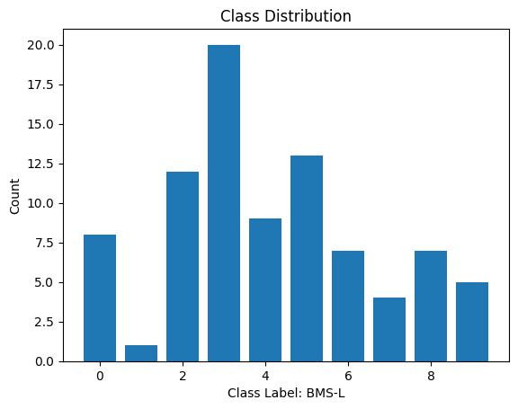
EDA
Class Imbalances – more prominent in BMS-L
Largely unimodal data, skew observed in certain columns
Potential detection errors

Slide 5
Cleaning
Combine CSVs according to ID
Dropped values
Empty rows
Columns above 95% likeness threshold
Originally dropped columns/rows missing >11% of values
Removed column of all ones [‘distance_nose_tail_median’]
Rows with no BMS-R or BMS-L values
Imputation

Slide 6
Models & Performance
Model | BMS-L | BMS-L | BMS-R | BMS-R
Logistic | 0.0714 | 0.0714 | 0.4286 | 0.4286
Random Forest | 0.5 | 0.5 | 0.5714 | 0.5714
XGBoost | 0.5714 | 0.5714 | 0.6429 | 0.6429
KNN | 0.1429 | 0.1429 | 0.3571 | 0.3571
Simple Neural Network | 0.1429 | 0.1429 | 0.3571 | 0.3571
Decision Tree | 0.4286 | 0.4286 | 0.6429 | 0.6429
**Also attempted Ridge/Lasso, ordinal logistic regression, h2o library

Slide 7
Current Approach
Instead of removing columns with >11% NaN values, models capable of natively handling NaN values were chosen
XGBoost
CatBoost
LightGBM
Hist Gradient Boosting Classifier
Hyperparameter tuning
All current models regularly achieve accuracy rates between 70% and 80%

Slide 8
Future Considerations
Class Imbalances
Artificially balance classes (potential data loss/worse model performance)
More data to supplement model training
Further research into models, specifically neural networks, capable of considering NaN values
Using raw data/supplementing with alternative calculated values

